Slide 1
Open RAN
Dian Hanifudin Subhi

Slide 2
Outline
Weekly report
Summary of this week’s work
Your work
Conclusion
Your opinion/thought
Action item

Slide 3
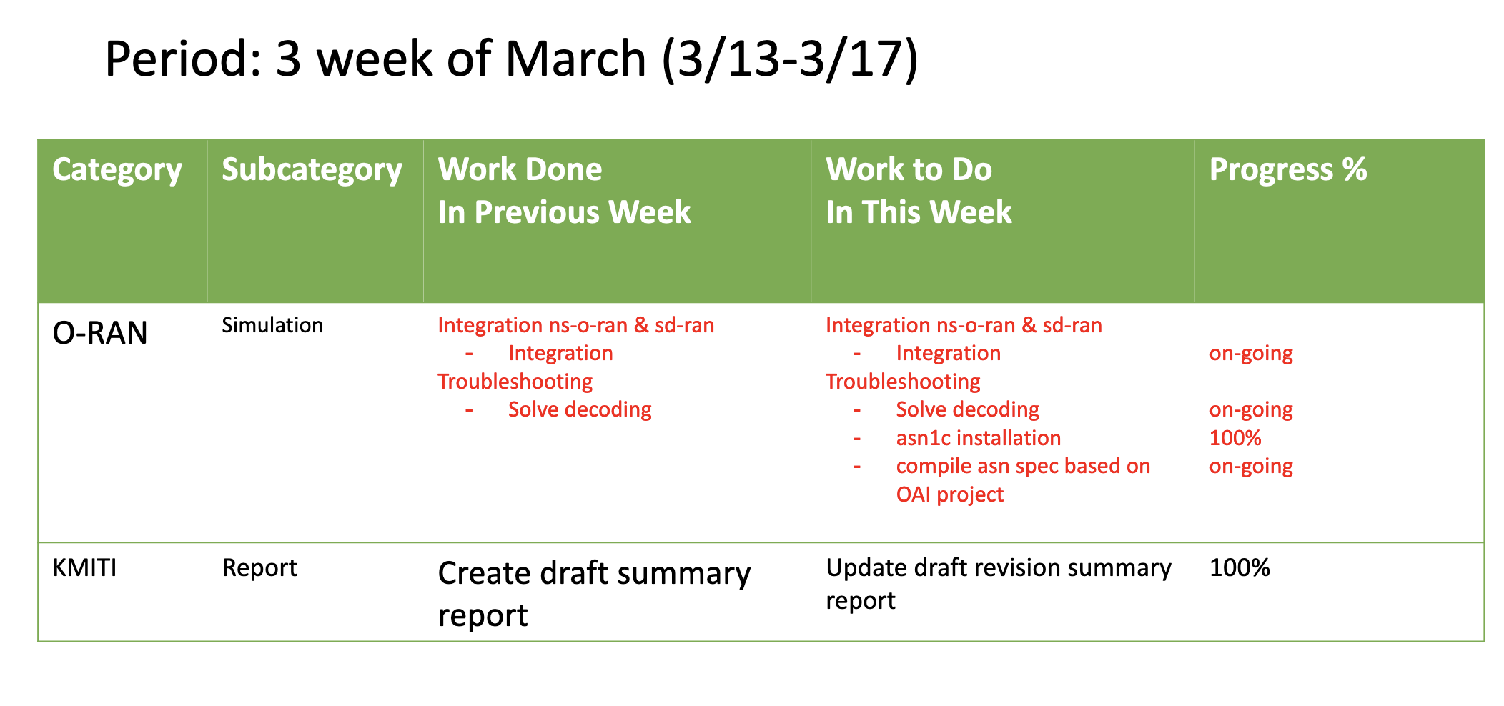
Weekly report

Slide 4
Summary of work this week
Update draft summary report of KMITI
Progress ns-3 integration with SD-RAN

Slide 5
Question to be Answered
How is the progress of ns3 integration with SD-RAN?

Slide 6
Draft report of KMITI
Update summary and future plans
Read interim report from previous report
Create summary and future plans based on the ICGHIT paper and other references

Slide 7
ASN.1
asn1c installation
git clone https://github.com/nokia/asn1c
navigate to asn1c directory
test -f configure || autoreconf -iv
./configure
make
make check
sudo make install

Slide 8
ASN.1
Identify asn and C files
O-RAN define the asn files in https://github.com/o-ran-sc/ric-plt-e2/tree/master/RIC-E2-TERMINATION/3rdparty/asnTextFiles
onos-e2-sm provide the output of asn compilation in servicemodels directory https://github.com/onosproject/onos-e2-sm/tree/master/servicemodels

Slide 9
Compilation
Modify cmakelist
add additional directory to https://github.com/dhanifudin/ns-o-ran-e2-sim/tree/develop/e2sim/src to store .c and .h file
Modify library and targets in cmakelist.txt
Error still exist because undefined member and function

Slide 10
Conclusion
Update draft summary report of KMITI
Adjust ASN.1 needed to ensure ns3 and sd-ran using same protocol

Slide 11
Your opinion/thought
Hit and trial is needed to solve encoding/decoding issue

Slide 12
Action items
Adjust compatibility for specific service models one by one (KPM, RC etc)

